Slide 1
Enthalpy, H
By definition, H=U+PV, so it’s an energy; numerically larger than U since PV>0
An extensive function (since U is extensive)
Usually we like to visualize H in T-P state space, so H=H(T,P)
H is “about” heat, as we’ll see

Slide 2
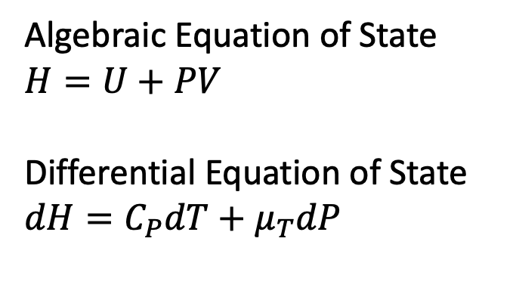

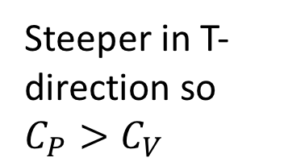
We like to think about enthalpy in a T,P state space
Algebraic Equation of State
$U$ = internal energy
Differential Equation of State
$$dU=C_{V}dT+π_{T}dV$$
Algebraic Equation of State
$$H=U+PV$$
Differential Equation of State
$$dH=C_{P}dT+μ_{T}dP$$
U(T,V)
H(T,P)
Steeper in T-direction so $C_{P}>C_{V}$
V
P
T
T
T-V state space
T-P state space

Slide 3
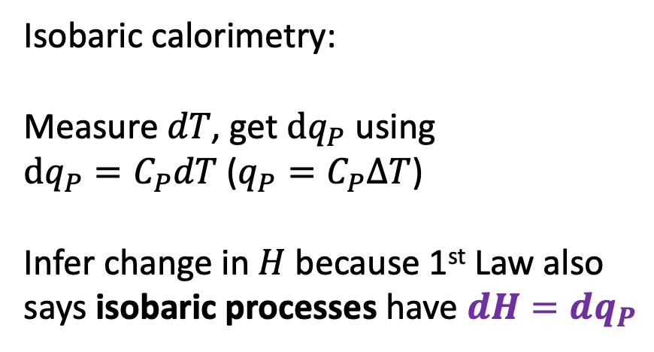
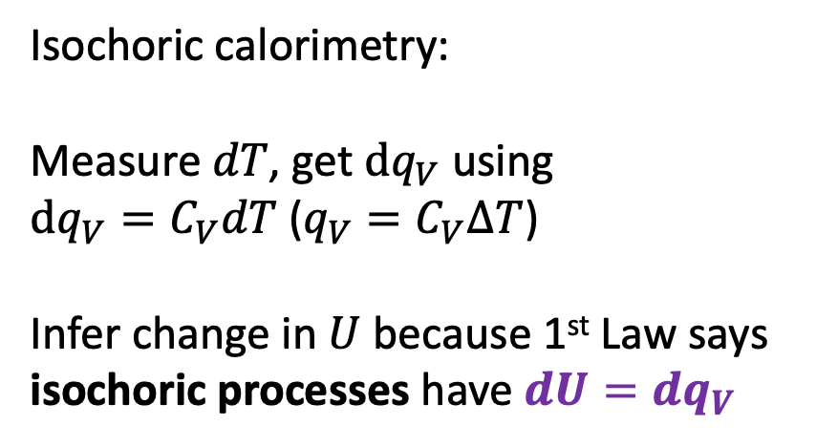
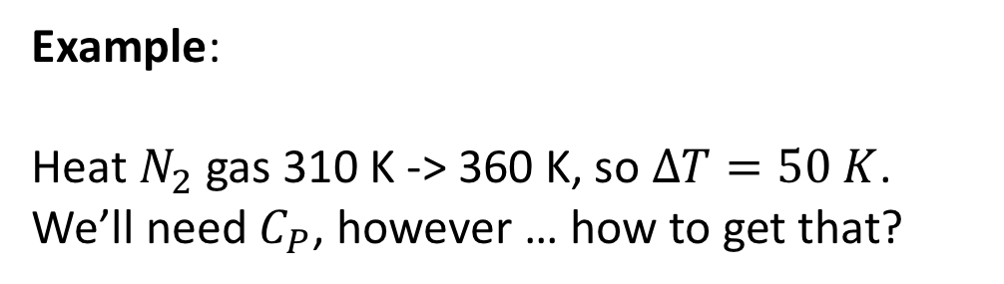
Enthalpy and calorimetry
Isochoric calorimetry:
Measure $dT$, get $dq_{V}$ using
$dq_{V}=C_{V}dT$ (${q_{V}=C}_{V}∆T$)
Infer change in $U$ because 1st Law says isochoric processes have $dU=dq_{V}$
Isobaric calorimetry:
Measure $dT$, get $dq_{P}$ using
$dq_{P}=C_{P}dT$ (${q_{P}=C}_{P}∆T$)
Infer change in $H$ because 1st Law also says isobaric processes have $dH=dq_{P}$
Example:
Heat $N_{2}$ gas 310 K -> 360 K, so $∆T=50 K$. We’ll need $C_{P}$, however … how to get that?

Slide 4

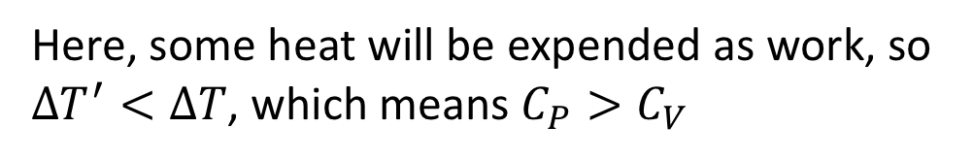
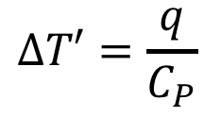
Relating $C_{P}$ to $C_{V}$ … Physical idea: $C_{P}>C_{V}$ … why?
w
q
$$∆T=\frac{q}{C_{V}}$$
q
$$∆T′=\frac{q}{C_{P}}$$
Here, some heat will be expended as work, so $∆T^{′}<∆T$, which means $C_{P}>C_{V}$

Slide 5
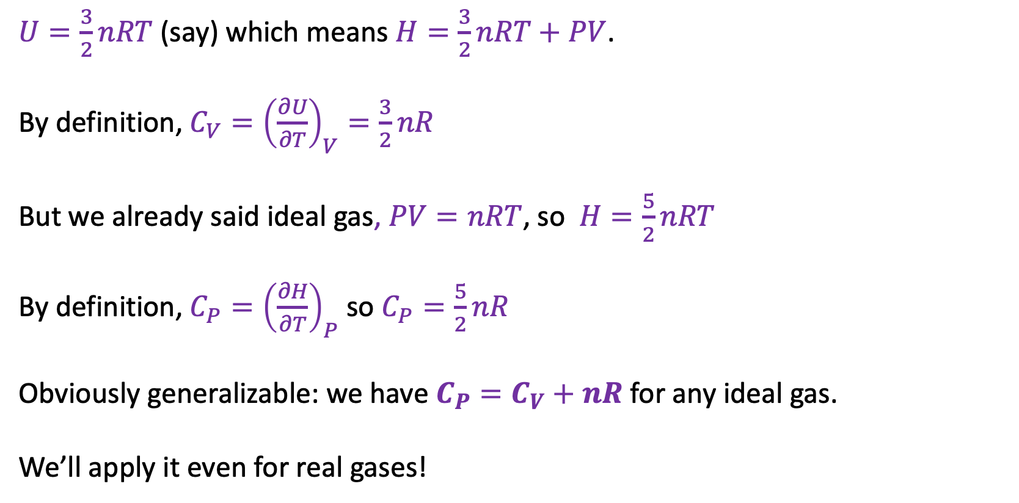
Relating $C_{P}$ to $C_{V}$ … Mathematical idea: let’s derive $C_{P}$ from $C_{V}$ … how? Assume an ideal gas …
$U=\frac{3}{2}nRT$ (say) which means $H=\frac{3}{2}nRT+PV$.
By definition, ${C_{V}=\left(\frac{∂U}{∂T}\right)}_{V}=\frac{3}{2}nR$
But we already said ideal gas, $PV=nRT$, so $H=\frac{5}{2}nRT$
By definition, ${C_{P}=\left(\frac{∂H}{∂T}\right)}_{P}$ so $C_{P}=\frac{5}{2}nR$
Obviously generalizable: we have $C_{P}=C_{V}+nR$ for any ideal gas.
We’ll apply it even for real gases!

Slide 6
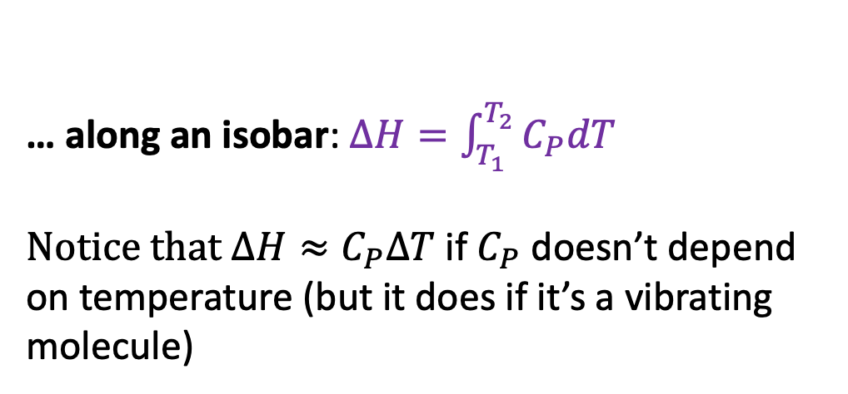

Finding changes in enthalpy when cruising through P,T space …
… along an isobar: $∆H=\int_{T_{1}}^{T_{2}}{C_{P}dT}$
Notice that $∆H≈C_{P}∆T$ if $C_{P}$ doesn’t depend on temperature (but it does if it’s a vibrating molecule)
H(T,P)
P
T
… along an isotherm:$∆H=\int_{P_{1}}^{P_{2}}{μ_{T}dP}$
Notice that $∆H≈μ_{T}∆P$ if $μ_{T}$ doesn’t depend on pressure (but it usually does)

Slide 7



The twist (ideal vs real gases)
Ideal gas: $H=H(T)$, so $μ_{T}=0$
Real gas: $H=H(T,P)$, so: $μ_{T}≠0$
But … there is a pattern!
Low temperature: $μ_{T}<0$
High temperature: $μ_{T}>0$
In between ($T_{I}$), we have $μ_{T}=0$
That in-between temperature is called the inversion temperature, $T_{I}$
$$μ_{T}>0$$
$$μ_{T}<0$$

